Slide 1
4FD3 project specification –Initial
Predict NBA games on Web portal
Member: Branislav Kukulj, Emily Ramanna, Mingming Zhang, Wenbo Liu
Jan 17,2022
Notes:
Welcome to team 2 marketing plan presentation on the ecommerce solution: Shopify. Forgive us if we mistake it for Spotify from time to time.

Slide 2
Project scopes and objectives
Using different ML models such as Logistic regression, Random tree etc. to achieve the best accuracy and understanding the underlying differences
Demonstrated abilities of dataset cleaning, normalization and features engineering
Web programming GUI application to achieve user-friendly experiences
Application of multiple languages such as Python, JavaScript, Node.js and interaction with database such as MySQL, cloud based Redis etc.
Implementation of multiple architecture patterns to achieve functional and non-functional requirements

Slide 3
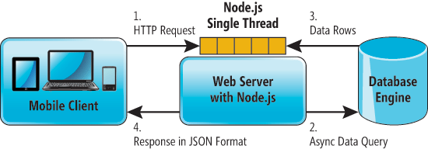
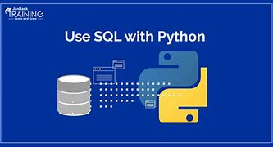
Full stack physical view
Notes:
Strengths:
Simplicity: Shopify provides a clean and crystal clear interface for business owner to navigate
Unique beautiful storefront themes: Provides a wide range of design template for almost every business needs in different industry
Security: The company streamlines the security and compliance side of the business
App Store: The company has its own app store and their plugins are one of their strongest aspects . This provides merchant with differentiated technology offerings
Weaknesses:
Scalability: Poor for international scalability because the platform relies heavily with third party apps
SEO (Search Engine Optimization): The company focuses on load time and speed rather than SEO
Out of the Box: Shopify offers some free features but very limited
Source: https://paulnrogers.com/shopify-plus-pros-cons/
Source: https://acquireconvert.com/shopify-review/

Slide 4
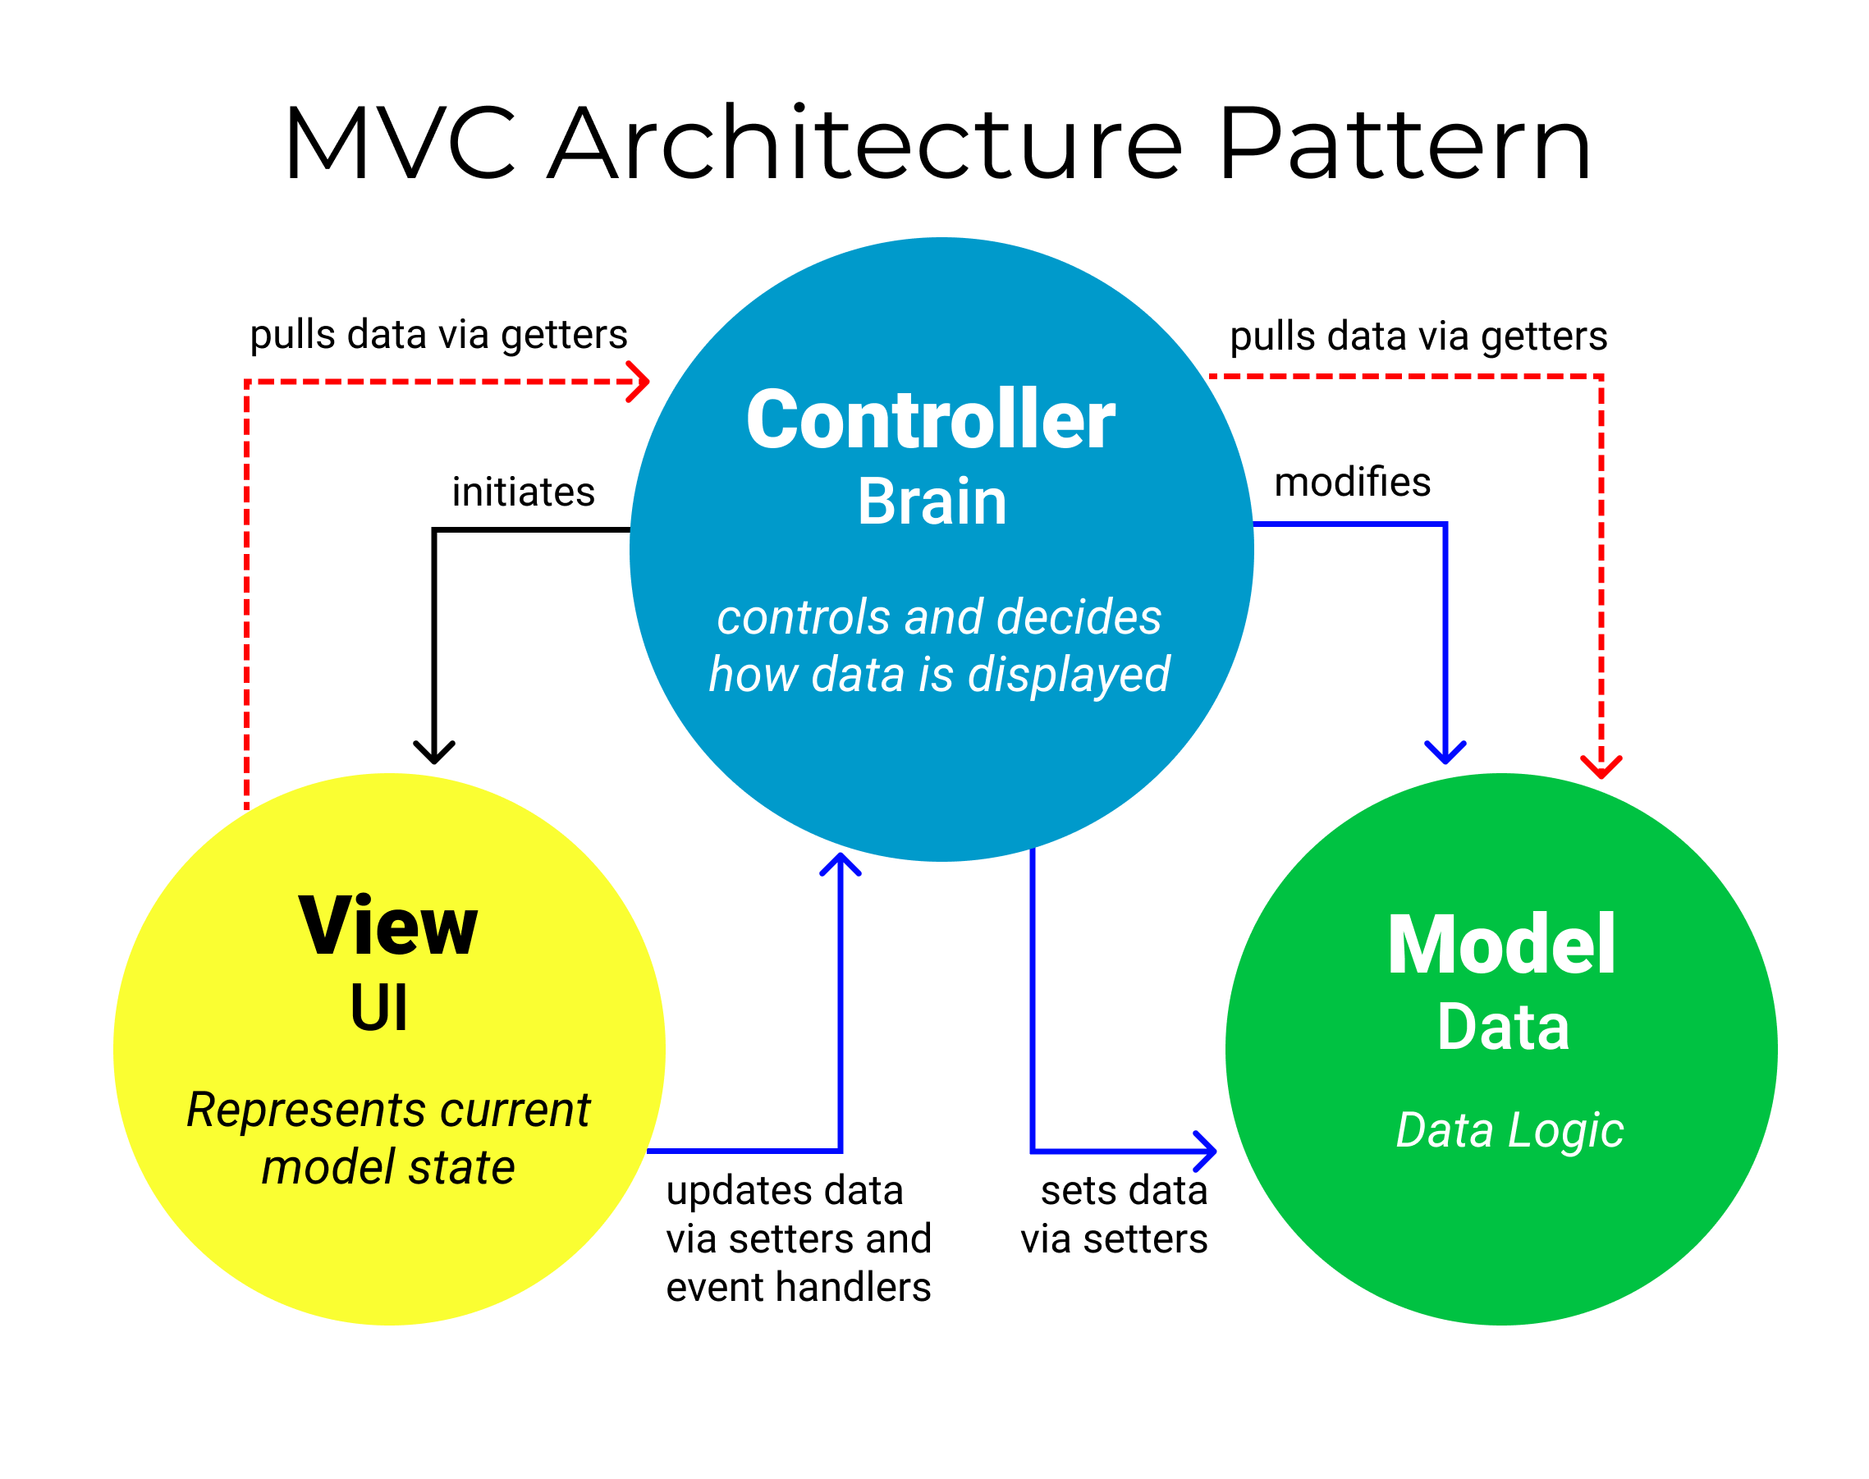
Design pattern
Users can create account and log in/out
Users can create pool and invite others (multiple)
Predict win or loss for daily NBA games
Review leaderboard in the pool
Select different machine learning algorithm
Other use cases
Notes:
Source: https://www.bigcommerce.com/blog/mobile-commerce/#why-does-mobile-commerce-matter
Source: https://www.shopifyandyou.com/blogs/news/statistics-about-shopify

Slide 5
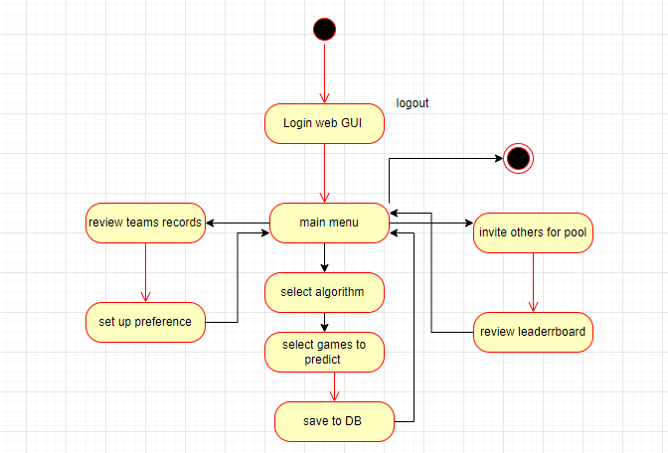
Logic View

